Slide 1
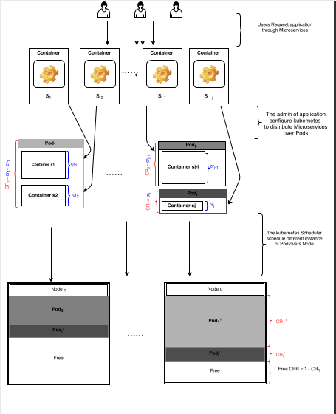
Distribution of Microservices on Pods
Work with Alfredo Goldman (USP Sao Paolo) and Denis
Configurations :
Users Request application through Microservices
The admin of application configure kubernetes to distribute Microservices over Pods
The Kubernetes Scheduler schedule different instance od Pod overs Node

Slide 2
Distribution of Microservices on Pods
Work with Alfredo Goldman (USP Sao Paolo) and Denis
Problems:
What is the impact of the first
distribution of Microservices overs Pod?
What is the impact of this distribution
on the Communication and on
the Microservices,
What is the impact of this distribution
on the auto-scaler?

